Slide 1
Embedded Systems

Slide 2

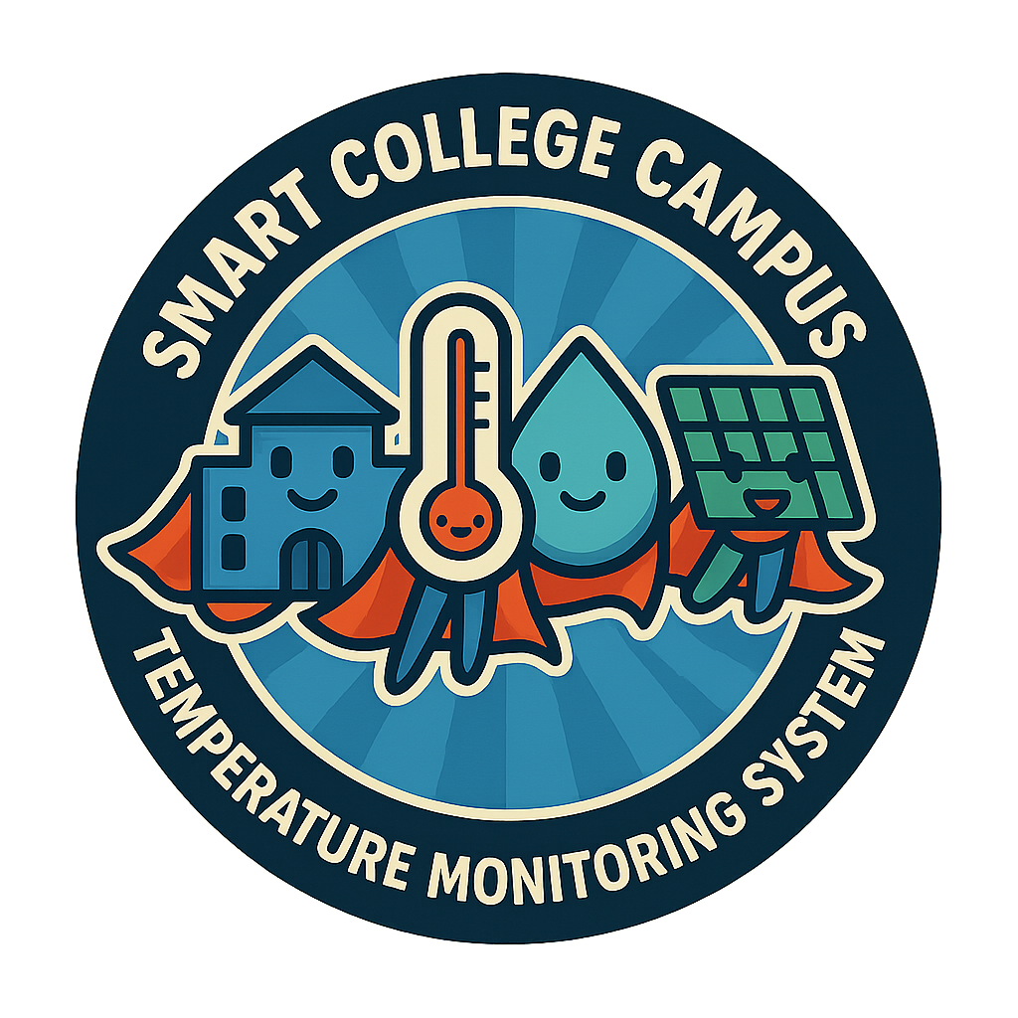
Smart College Campus Temperature Monitoring System

Slide 3
Home
About Us
Project Overview
This project aims to develop a smart, solar-powered system to monitor temperature and humidity across the college campus using IoT technology.
It uses an ESP32 microcontroller and DHT22 sensor to collect data, which is transmitted wirelessly via Wi-Fi and displayed on a live web dashboard. The system runs on renewable energy, supports real-time monitoring, and helps in building a smarter and more eco-friendly campus environment.
Page | 3

Slide 4
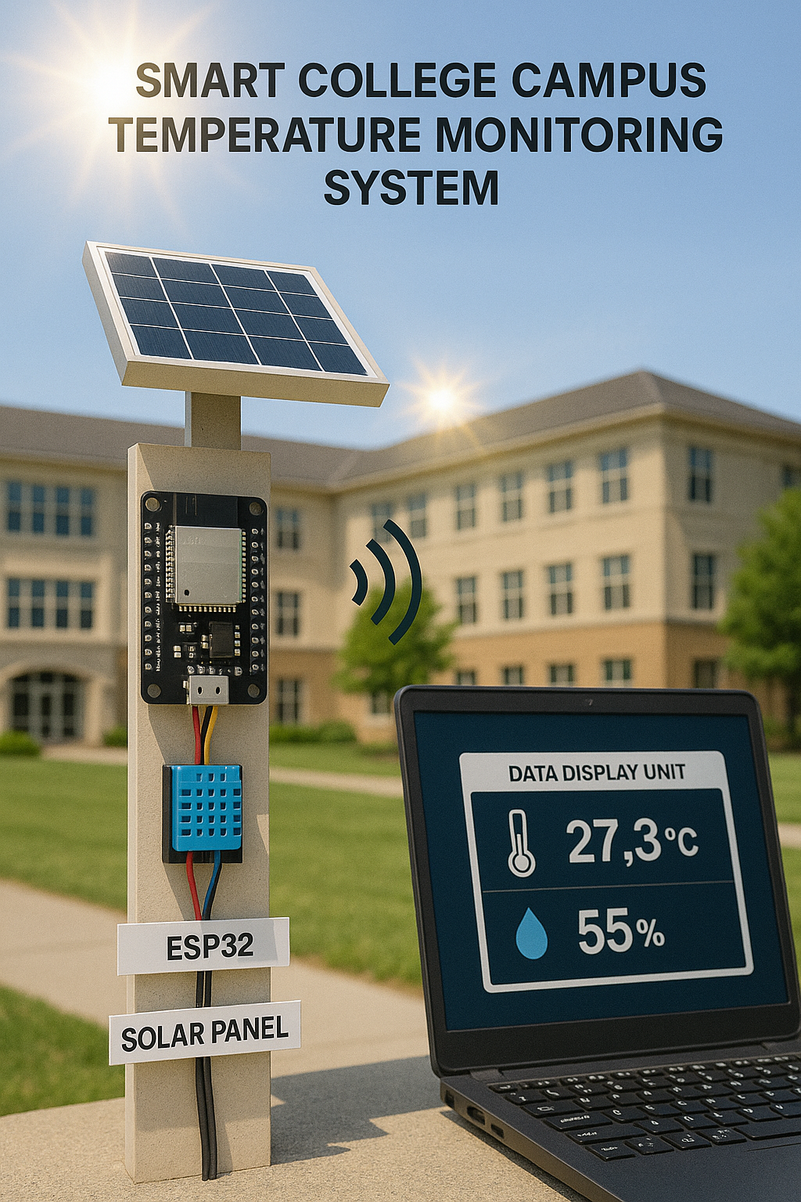
Introduction
This project aims to build a Smart Temperature Monitoring System for our college campus using IoT technology. It collects real-time temperature,
humidity, and heat index data using ESP32 and DHT22 sensors, powered by solar energy, and displays the data on the college website for easy monitoring.

Slide 5
Objectives
To monitor temperature, humidity, and heat index in real-time using sensors.
To utilize ESP32 with Wi-Fi for wireless data transmission.
To display the collected data on the college website using a web dashboard.
To ensure continuous power supply using a solar panel and battery.
To develop an energy-efficient, scalable, and eco-friendly monitoring system.
To improve environmental awareness and campus safety through real-time data.

Slide 6
Components Used
ESP32 | Microcontroller with built-in Wi-Fi
DHT22 Sensor | Measures temperature and humidity
Solar Panel | Provides renewable energy to the system
Battery | Stores energy from the solar panel
7805 Voltage Regulator | Regulates and maintains a stable 5V output
Connecting Wires | Used to build the circuit connections
Breadboard | Circuit prototyping platform
XAMPP Server (Apache + MySQL + PHP)
Runs local server with PHP and MySQL support
www.reallygreatsite.com
Software to write and upload code to ESP32
Page | 6
Arduino IDE

Slide 7

Working Principle
Sense: DHT22 captures temperature & humidity at set intervals.
Process: ESP32 wakes, reads the sensor, verifies checksum.
Connect: ESP32 joins campus Wi-Fi and opens an HTTP session.
Upload: Readings are posted to a PHP script on the XAMPP server.
Store: PHP time-stamps the data and inserts it into a SQL table.
Display: A web page auto-fetches the latest record and shows live values to users.

Slide 8

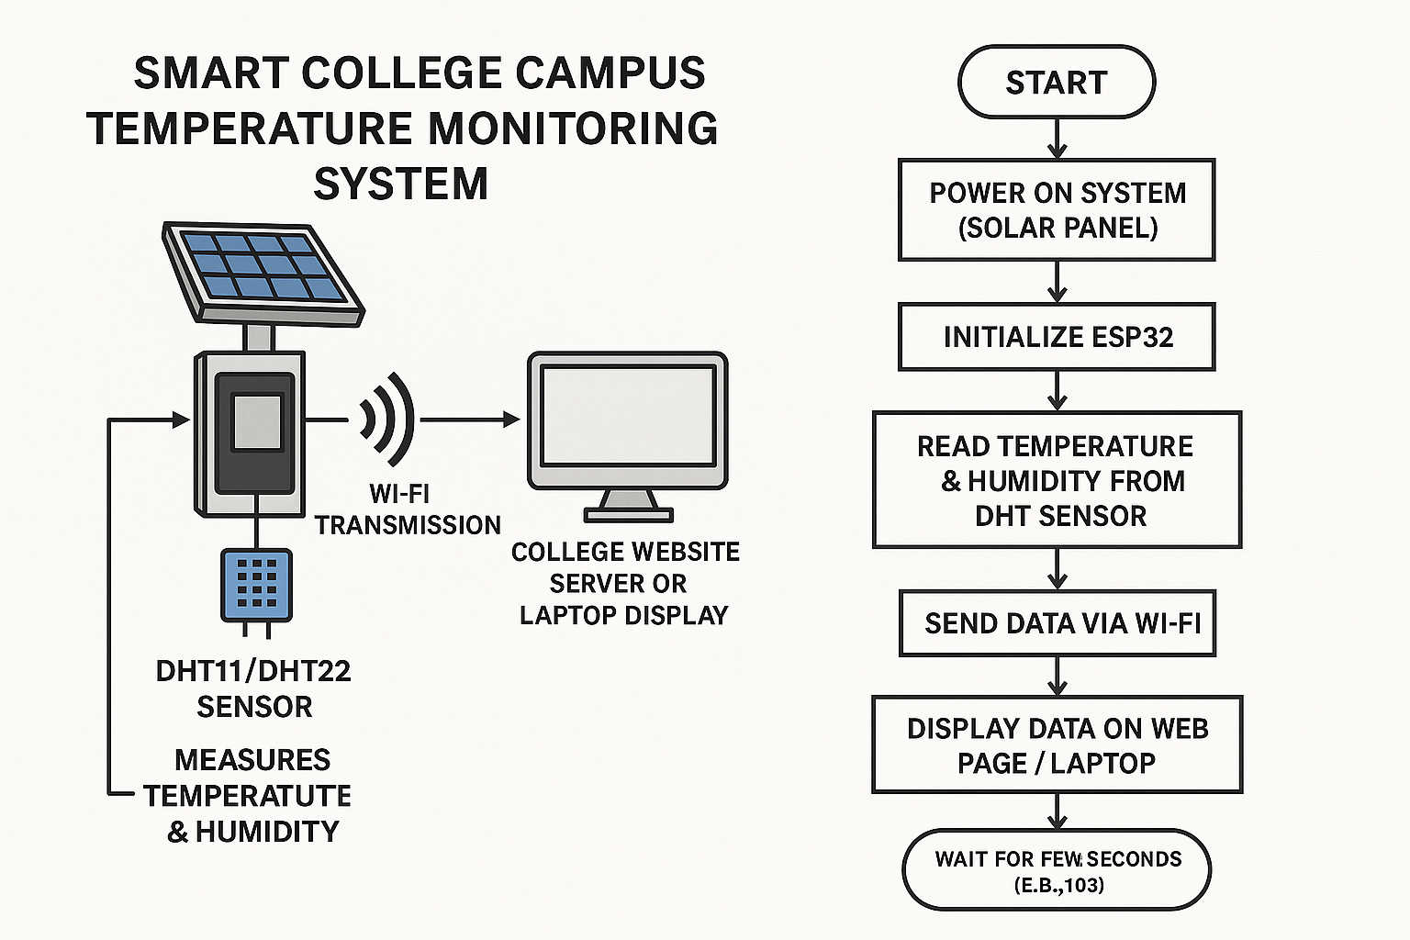
Block Diagram and Flowchart

Slide 9
Implementation
The ESP32 microcontroller reads real-time temperature and humidity data from the DHT22 sensor. It is programmed using Arduino IDE with Embedded C code for efficient data handling.
Power is supplied using a solar panel connected to a rechargeable battery through a voltage regulator, which ensures a stable 5V output to run the ESP32.
The ESP32 connects to Wi-Fi and transmits the collected sensor data to a local web server using HTTP POST requests, making the system completely wireless.
A PHP script running on the XAMPP server receives the data and stores it into a SQL database. The stored readings are managed and viewed through phpMyAdmin.
A webpage developed using HTML fetches the latest values from the database and displays them live with auto-refresh, enabling real-time monitoring from the college website.

Slide 10

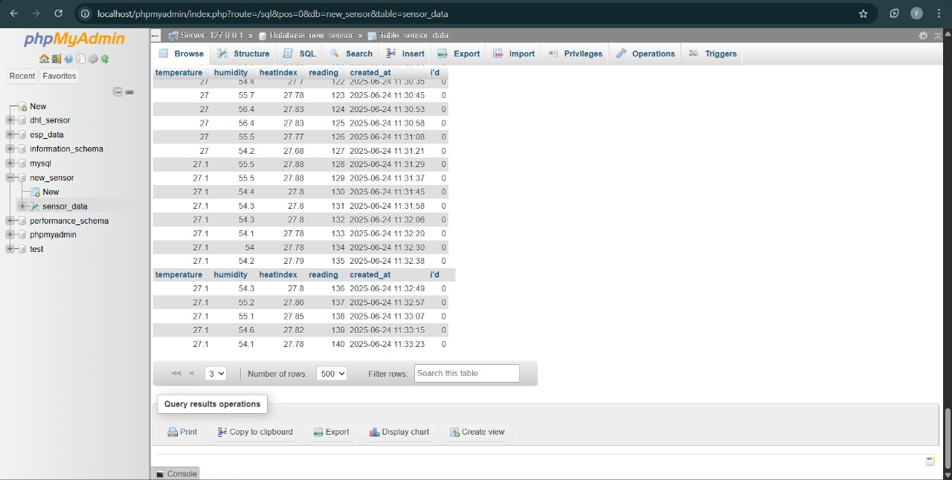
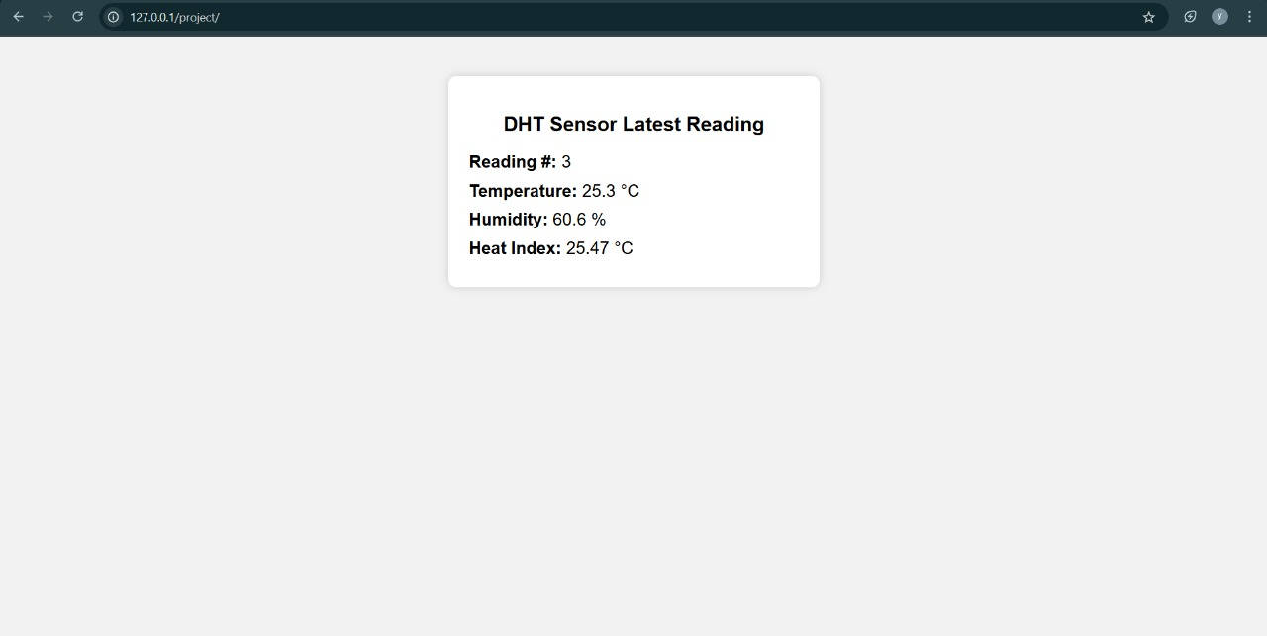
Results and Output

Slide 11
Advantages
Enables real-time temperature and humidity monitoring across the campus.
Eco-friendly system powered by a solar panel, reducing electricity usage.
Completely wireless setup using ESP32 with built-in Wi-Fi.
Uses low-cost components, making it affordable and easy to maintain.
Auto-updating dashboard allows continuous monitoring without manual work.
Data is stored securely in a SQL database for future analysis or reporting.
Helps in creating a safe and comfortable environment for students and staff.

Slide 12
Applications
Smart Campus Management: Monitor and control environmental conditions across educational institutions.
Green Building Systems: Used in buildings focused on sustainability and smart automation.
Weather Data Collection: Collects localized weather data useful for academic and environmental studies.
IoT-based Research Projects: Serves as a base model for students working on IoT and embedded systems.
Agricultural Monitoring: Can be adapted to monitor environmental conditions in polyhouses or farmlands.
Disaster Alert Systems: Helps in detecting abnormal temperature and humidity trends, supporting early warnings.

Slide 13
Conclusion
This project provides a simple, low-cost, and eco-friendly solution for real-time temperature and
humidity monitoring. It promotes smart campus management through wireless data transmission
and live web display, making the system efficient and easy to maintain.

Slide 14






Team Members
Gollapalli Jyothi Sai Team Lead & Project Coordinator
Kommanapalli Yeswanth Software Implementation
Golagani Govind Sensor Integration & hardware setup
Sigurla Nandesh Testing & Documentation

Slide 15
Thanks for Your
Attention

